Slide 1
ANCOVA & REPEATED MEASURES
By:
Dr. Rose Kigathi

Slide 2
Linear models
Assumptions of linear models (lm,aov in r)
Random sampling
Constant variance
Normal errors
Additive effects
Independence of errors

Slide 3
ANOVA
Hypothesis testing
Estimate means and standard error of differences between means
Variance= Sum of squares
Degrees of freedom

Slide 4
ANOVA Table
Source | SS | d.f. | MS | F | Critical F
Treatment (systematic) | SSA | k-1 |  |  | qf(0.95, k-1,k(n-1))
Error (Unsystematic) | SSE | k(n-1)
Total | SST | kn-1
Ho: all means are the same
S²=MSE
H1: Atleast one of the means is significantly different from the others

Slide 5
Violation of independence
Sometimes data collected is not independent
Spatial correlation
blocks in field experiments
Sample from similar areas
Temporal correlation
Masurements made over time (on same object or area)
Repeated measures ANOVA

Slide 6
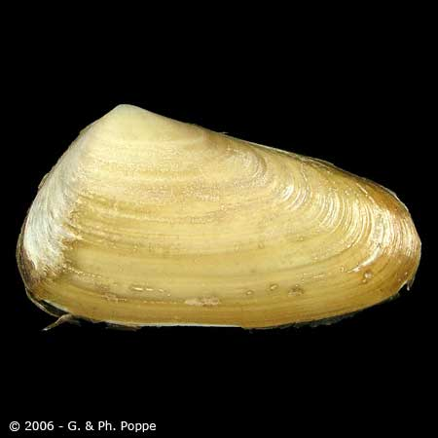
ANCOVA-brief
combines elements from regression and analysis of variance
Example using data= Clam

Slide 7
Intercept for month 2
Coefficients:
Estimate Std. Error t value Pr(>|t|)
(Intercept) -11.48318 0.20049 -57.274 < 2e-16 ***
LNLENGTH 3.03740 0.06508 46.674 < 2e-16 ***
fMONTH3 0.57761 1.68290 0.343 0.73162
fMONTH4 0.03783 0.21698 0.174 0.86167
fMONTH9 -0.61448 0.35031 -1.754 0.08020 .
fMONTH11 0.94007 0.34068 2.759 0.00607 **
fMONTH12 1.68056 0.97240 1.728 0.08474 .
LNLENGTH:fMONTH3 -0.29988 0.72241 -0.415 0.67829
LNLENGTH:fMONTH4 -0.07172 0.07232 -0.992 0.32197
LNLENGTH:fMONTH9 0.15166 0.13162 1.152 0.24993
LNLENGTH:fMONTH11 -0.30605 0.11597 -2.639 0.00865 **
LNLENGTH:fMONTH12 -0.57034 0.31532 -1.809 0.07127 .
Intercept month 2
Difference btwn intercept
Slope for month 2
Difference btwn slopes (2-3)

Slide 8
Repeated measures
Advantages
Less costs, fewer subjects
More statistical power

Slide 9
Repeated measures ANOVA
Reduced Costs
When measurements are made on subjects repeatedly
Before-after measurements
Reduce costs
Sometimes repeated measures are done to reduce costs

Slide 10
Repeated measures ANOVA
More statistical power
tests for systematic variance between groups
If so it will not contribute to the error term
Sytematic variance/
Between group variance
Sytematic
Unsytematic variance
Unsytematic
Subjects
Source: Andrew conway, 2013

Slide 11
F test= Amount of error you observe/error you expect due to chance
F=MS_{A}/MS_{E}
For repeated measures
F=MS_{A}/MS_{AxS}

Slide 12
packages
Using nlme package
Fixed=y~x
Random=~ 1| a/b/c
Where 1 is the intercept
The symbol | is given
In the case above there are 2 random effects, b is nested within a
Eg tree/branch
Or using lme4 package
lmer(y ~ x+( 1 | a/b/c ))

Slide 13
Random Vs. Fixed Effects
Fixed effects influence only the mean of y;
Random effects influence only the variance of y.
Fixed effects are unknown constants to be estimated from the data.
Random effect should be thought of as coming from a population of effects
random effects are either categorical or continuous variables
we are often not interested in the parameter values, but only in the variance they explain.

Slide 14
Contrasts
Treatment contrasts
Helmert contrasts
Orthogonal contrasts
Are used in
hypothesis testing
model simplification
in analysis of variance and analysis of covariance.
There are many types of contrasts but only k − 1 orthogonal contrasts

